Slide 1
Paycheck Protection Program
Presented by
Chido Shamuyarira, Emma Darkwa, Shu-Ping Chen, Wei-Yu Jen
March 5, 2022 |ICU Challenge|
Notes:
Background and introduction: Wendy
Characteristics: Chido
Comparison: Emma, Wendy
Regression analysis: Zoe
Conclusion: Chido

Slide 2
Agenda
Background And Introduction
Findings
Conclusion
Notes:
1st : opening, background, methods
2nd: Findings -> characteristics for the removed data and comparison
3rd: Findings -> regression analysis
4th: Conclusion -> answer the final question
Answer questions -> 1st person, and other people can support

Slide 3

Background and Information
$ 800,000,000,000
Small Business Administration
Notes:
Enacted by Congress in 2020 to respond to the economic impact of the COVID-19 pandemic, the Paycheck Protection Program provided nearly $800 billion in loans to small businesses in order to retain payrolls. The Small Business Administration has oversight over the PPP program, although the loans are administered by private lenders, who then submit application information to the government. The loans could be fully forgiven if certain conditions were met.
The SBA has periodically released data on the more than 11.5 million approved applications, but it also has removed applications that had been previously present in the dataset.

Slide 4
Background and Information
?
Approve
Remove
Small Business Administration
Notes:
Enacted by Congress in 2020 to respond to the economic impact of the COVID-19 pandemic, the Paycheck Protection Program provided nearly $800 billion in loans to small businesses in order to retain payrolls. The Small Business Administration has oversight over the PPP program, although the loans are administered by private lenders, who then submit application information to the government. The loans could be fully forgiven if certain conditions were met.
The SBA has periodically released data on the more than 11.5 million approved applications, but it also has removed applications that had been previously present in the dataset.

Slide 5
Characteristics of Removed Applications

Slide 6
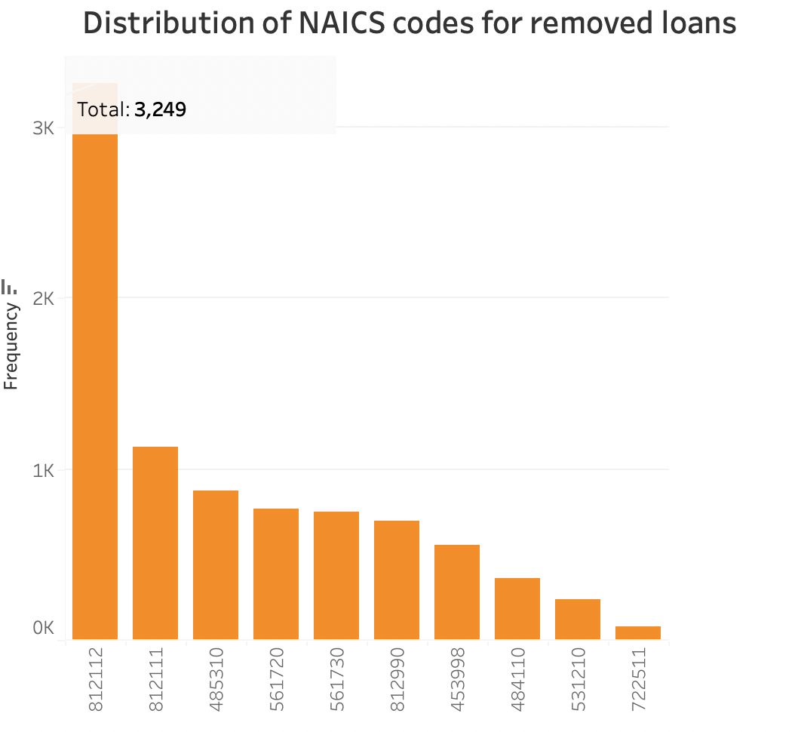
Beauty Salons
Notes:
The NAICS code classifies businesses and we found out that the code 812112 which represents beauty salons had the highest amount of removed businesses.

Slide 7
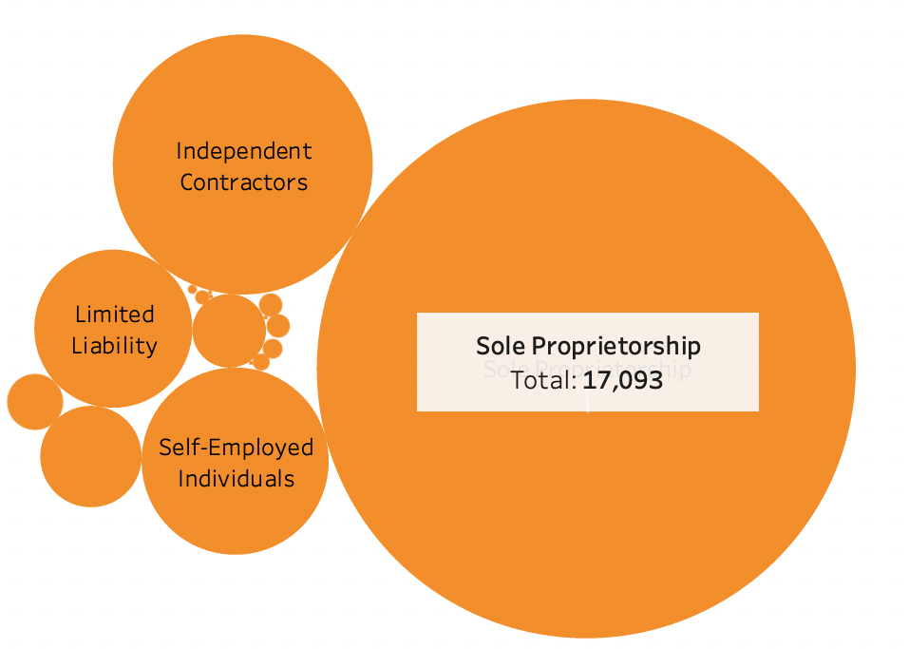
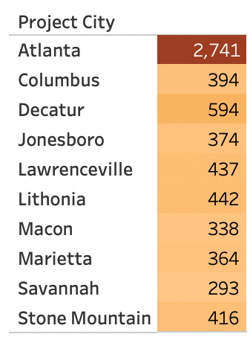
Removed Business Types
Notes:
The type of business which was removed the most was the sole proprietorship especially those located in the city of Atlanta

Slide 8
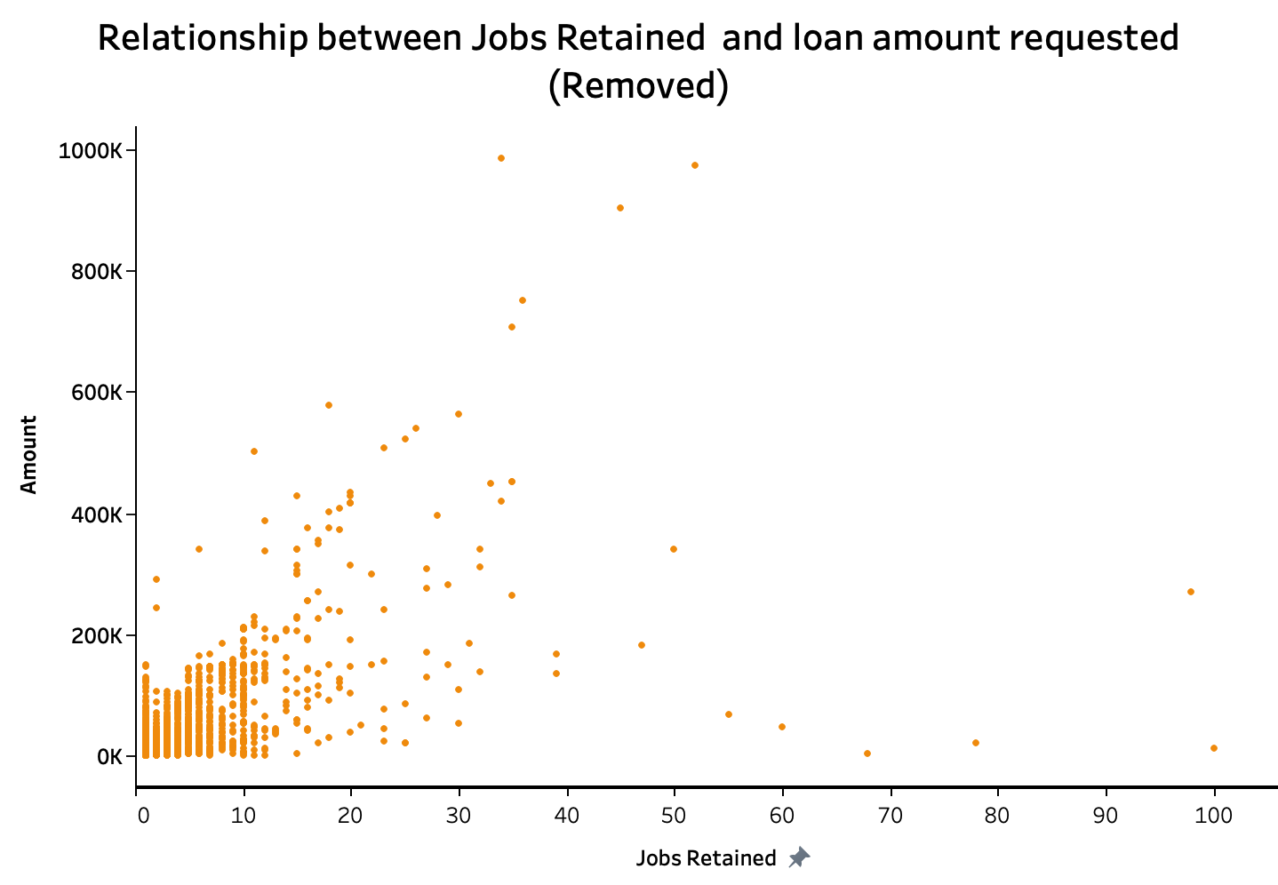
Notes:
As the amount increased the number of jobs retained increased as well. From this it is evident that most of the applications that were removed had amounts less than 200K".

Slide 9
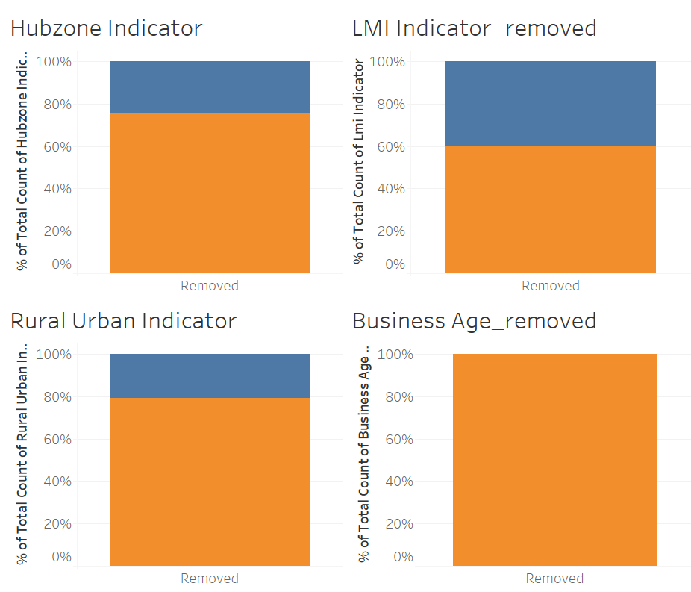
Hubzone
LMI
Non-Hubzone
Not LMI
Rural
Urban
Existing or more than 2 years old
Notes:
Hubzone indicator shows the Historically Underutilized Business Zone and the majority of loan application in the non-zones were removed. The majority of the loans removed were not for the low to Moderate income indicator. More applications from urban were removed and business that existed or have existed for more than 2 years dominated.

Slide 10
Comparison of applications removed vs remained

Slide 11
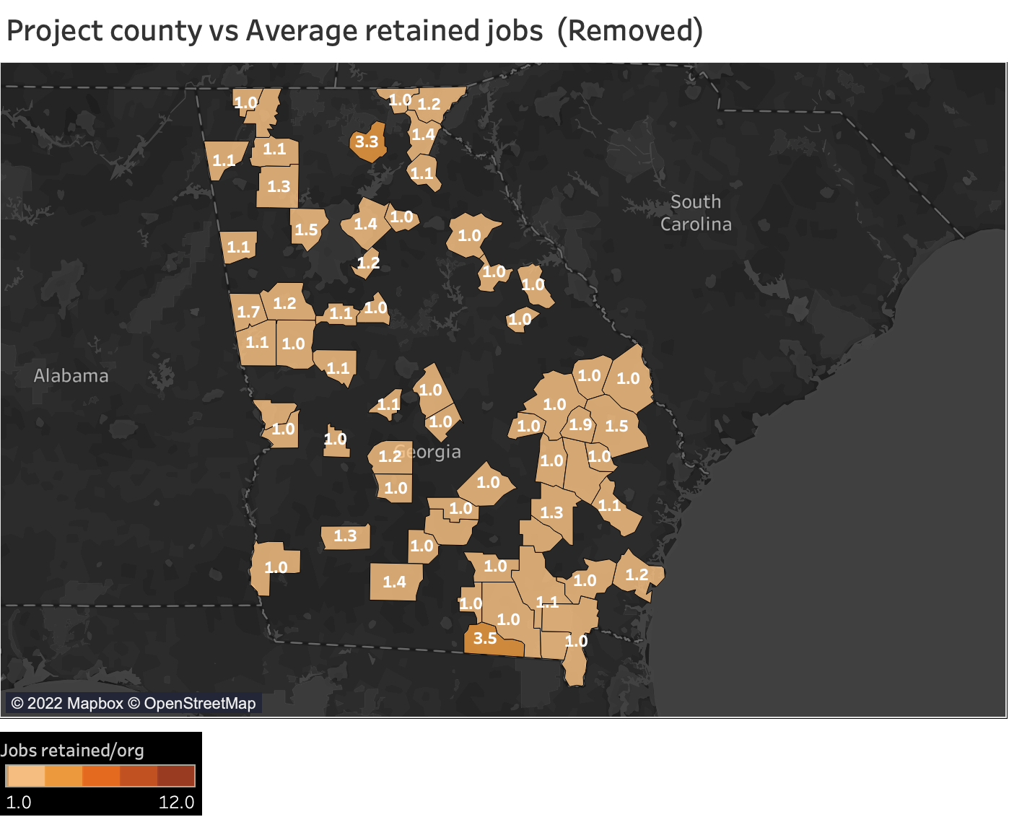
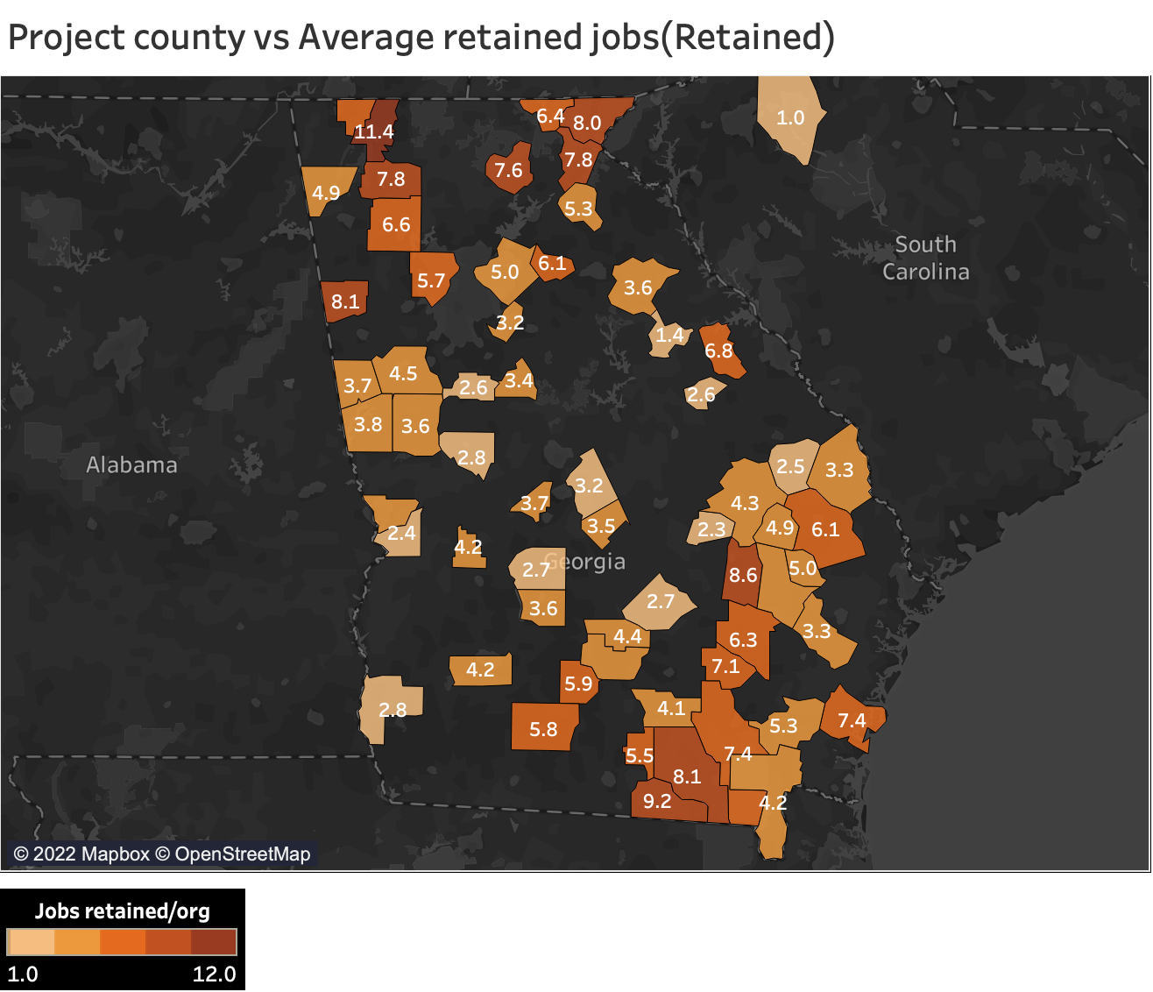
Job Retention
Average retained jobs in each county
(Removed Group)
Average retained jobs in each county
(Approved Group)
Notes:
There is higher average retained jobs in each county for the retained as compared to the removed. The SBA might have chosen to support these business to help retain jobs in that area which would overall improve the area economically as well as the state and nation as a whole.

Slide 12
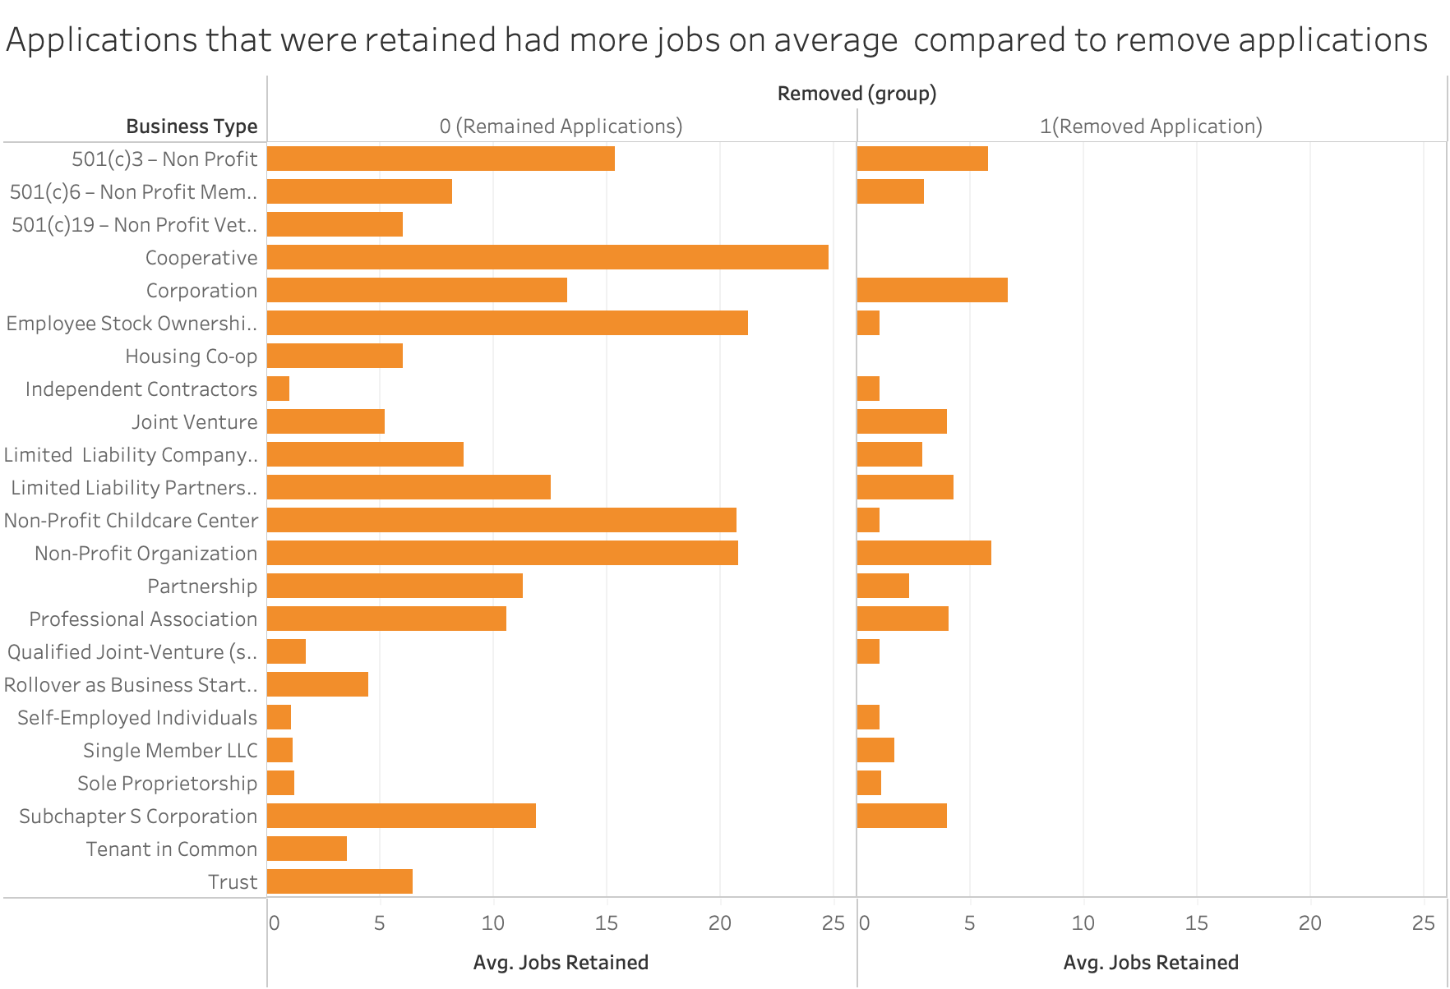
Approved
Removed
Business Type | Cohen’s d
All | 0.27
Without the 2 types | 0.37
Notes:
In the approved applications, we can see that in most of the business type there are more jobs retained than those in the removed applications.
When we look at the Cohen’s d, it says that the difference between these 2 groups are 0.27. However, we think that base on this graph, it looks like there is a greater difference.
Then we recall that the majority of removed loans are sole proprietorship, so we think that the 0.27 might because it was impacted by the dominated “1” job retained.
We remove the two business type that can only retain 1 job, and we found that the Cohen’s d get better, indicating even more difference between the 2 groups.
These tell us that the jobs retained between approved and removed applications is statistically significant.
Cohen’s D of 0.27 indicates that the two group means differ by 0.27 standard deviations.if it’s less than 0.2 it tells us that the group are not significantly different compared to what we may see on the chart.

Slide 13
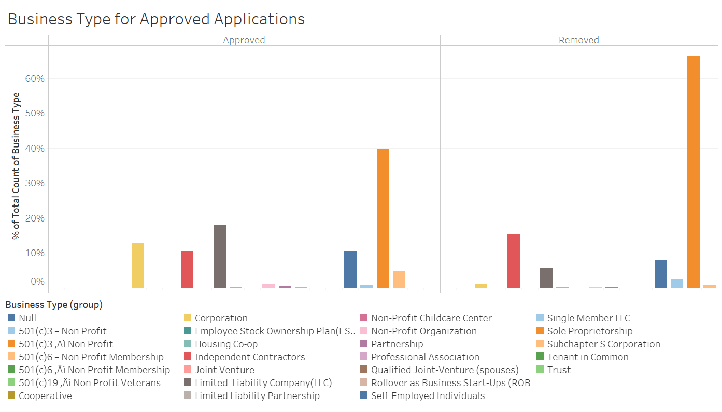
Sole Proprietorship
Sole Proprietorship
LLC
Independent
Contractors
Independent
Contractors
Corporation
LLC
Corporation
Notes:
After we get an idea of jobs retained in each business type. How about taking look at just the business type
Non-profit business type has the highest proportion in both groups, especially in the removed applications there are over 60% of them.
Also, we can see that the independent contractors is also one of the business types that might have great chances to be removed. There are 10.12% of approved applications are from independent contractors but 15.39% in the removed applications.
Corporation and LLC are two of the business types that have great chances to be approved. See that there are 12.74% of applications that are approved but only 1.23% in the removed applications.

Slide 14
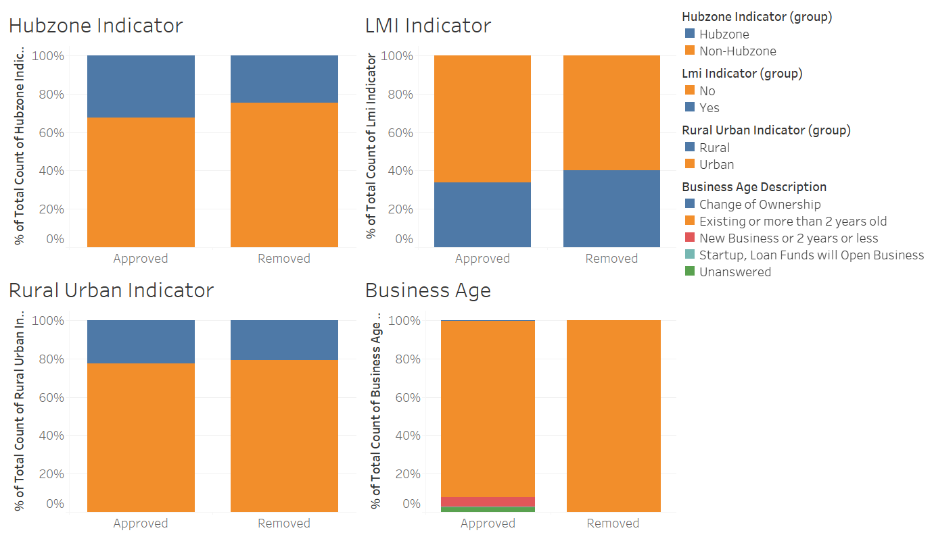
Hubzone
Hubzone
LMI
LMI
Non-Hubzone
Non-Hubzone
Not LMI
Not LMI
Rural
Rural
Urban
Urban
Cohen’s D effect sample sizes < 0.2
Notes:
We also compare the Hubzone, LMI, Rural Urban indicator for the approved and rejected loans. However, we found that there was no significant difference for these variables in the two groups. The Cohen’s d effect sample sizes are all less than 0.2, indicating that the difference is negligible.
And for the business age, although most of them are
Historically Underutilized Business Zone program that helps small businesses located in distressed areas gain preferential access to federal procurement opportunities.

Slide 15
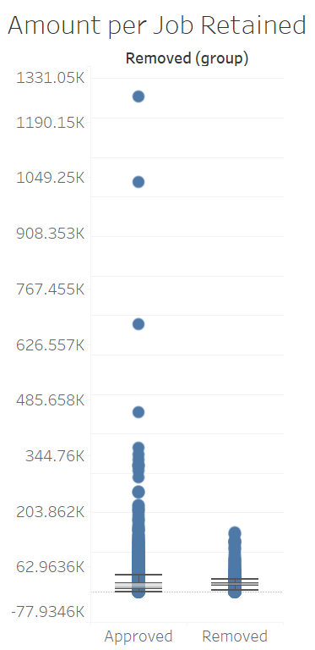
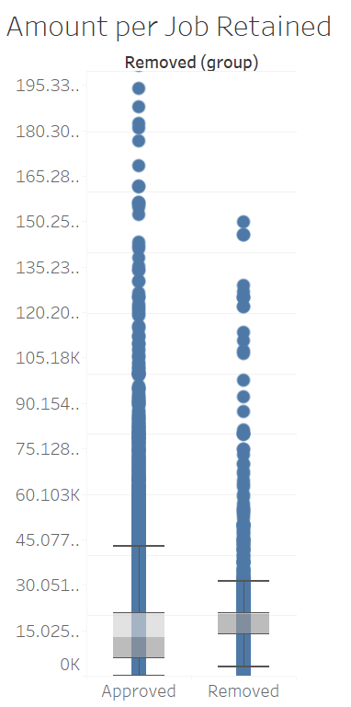
Cohen’s d = -0.54
→ medium effect size
Notes:
When we

Slide 16
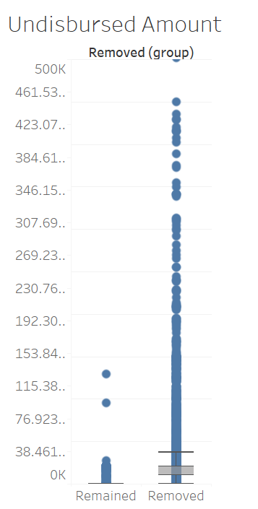
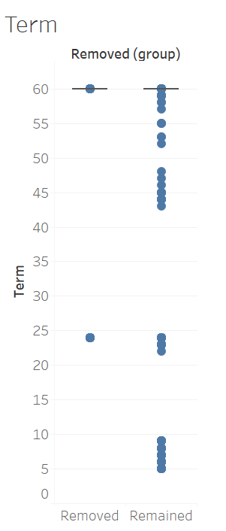
Cohen’s d = -0.38
small to medium effect size
Cohen’s d = -0.79
large effect size
Approved
Removed
Approved
Removed
Notes:
While we keep exploring the difference between approved and removed loans, we found that the undisbursed amount and term also are different from the two groups.
For undisbursed amount, it clearly shows that the amount for removed loans are a lot higher than the amount for approved applications.
As for the term, most of the removed loan has 60 months term while the term for approved applications varies a lot, and have many terms under 60.

Slide 17
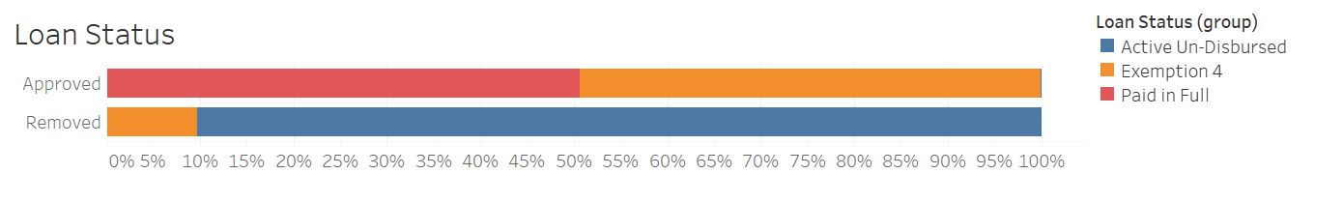
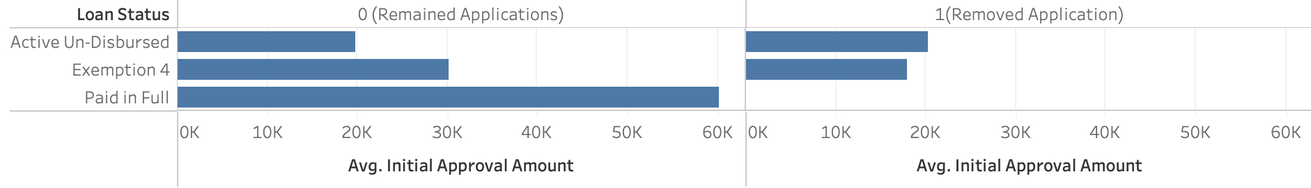
Approved
Removed
Notes:
From the plot above, we can learn that loan status is actually a very important variables that can tell us about the difference between approved and removed loans. For the approved applications, the loan status are all paid in full and exemption 4. As for the removed group, most of them are on “Active Un-Disbursed”, and some of them are on Exemption 4.
We also took a look at the relationship between initial approval amount and the loan status, we found that the average initial approval amount is the highest when the loan status is already paid in full.

Slide 18
Prediction

Slide 19
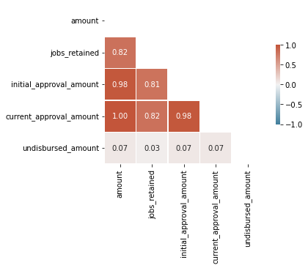
Correlation Plot

Slide 20
Logistic Regression Model
Dependent variable: removed (whether remove the loan application or not)
removed = 0: remain the loan application
removed = 1: remove the loan application
Independent variable:
business type: business type description
business_age_description
undisbursed_amount
term: loan maturity in months
job_retained
Accuracy of model with only one independent variable, loan_status = 1

Slide 21
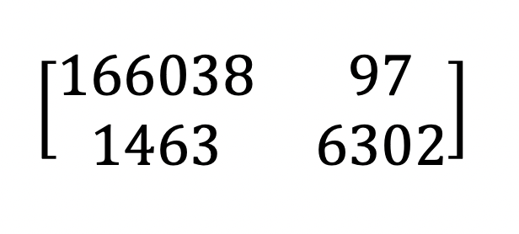
Classification Results
Confusion matrix:
Accuracy | 0.99
Sensitivity | 0.99
Specificity | 0.98
AUC from ROC curve | 0.905

Slide 22
Conclusion

Slide 23
Conclusion
Loan status is the most important variable
Other than the loan status, we can see that the following variables can also provide us insights and help predict if the data is removed from application dataset
Jobs retained
Business type
Business age
Undisbursed amount
Term
We can predict the results with more than 99% accuracy
Notes:
Why these applications were removed.
Considering the analysis results, they have removed loans mainly for businesses existing more than 2 years to support new businesses, perhaps after evaluation of application the banks may have realized these new business would need the money to support the start of the business.
Another reason would be to support business in different counties in the state of Georgia. They were a lot of applications that were retained for small business in counties where they were not a lot of business(may be 2 business in that area). The SBA might have chosen to support these business to help retain jobs in that area which would overall improve the area economically as well as the state and nation as a whole.
If we’re to GO BEYOND DATA, Data Privacy Laws gives people the right to not provide all information when asked for hence could explain some missing information in some variables such as the loan status data.Secondly missing variables such as ethnicity and gender existing in the current dataset could have helped us analyzed our data and have better reasoning behind the missing applications..

Slide 24
Conclusion
We think the reason for those loans that were removed from approved applications is because the lender decided to cancel them.
Since all the variables that we found important to make the prediction cannot be found from the PPP application form, we believe that the lender decide to cancel the loan application after reviewing more detailed information.
Jobs retained - so maybe the lender learned that the jobs retained amount didn’t seems reasonable for the loan amount, they canceled it.
Business type - maybe the lender got more information about the business and found the business is not reliable and might not use the loan well
Business age - the government might prefer to put more funding to new and start-up businesses
Undisbursed amount - because lenders haven’t fully disbursed the loan, so it’s ok to cancel it
Term - the lender prefer to provide loans with shorter term
Loan status - most of the removed loans are on “Active Un-Disbursed”, so the lender will not lose any when removing them from the application dataset
Notes:
Why these applications were removed.
Considering the analysis results, they have removed loans mainly for businesses existing more than 2 years to support new businesses, perhaps after evaluation of application the banks may have realized these new business would need the money to support the start of the business.
If we’re to GO BEYOND DATA, Data Privacy Laws gives people the right to not provide all information when asked for hence could explain some missing information in some variables such as the loan status data.Secondly missing variables such as ethnicity and gender existing in the current dataset could have helped us analyzed our data and have better reasoning behind the missing applications..

Slide 25
Conclusion
If we’re to GO BEYOND DATA, Data Privacy Laws gives people the right to not provide all information when asked for hence could explain some missing information.
Notes:
Why these applications were removed.
Considering the analysis results, they have removed loans mainly for businesses existing more than 2 years to support new businesses, perhaps after evaluation of application the banks may have realized these new business would need the money to support the start of the business.
If we’re to GO BEYOND DATA, Data Privacy Laws gives people the right to not provide all information when asked for hence could explain some missing information in some variables such as the loan status data.Secondly missing variables such as ethnicity and gender existing in the current dataset could have helped us analyzed our data and have better reasoning behind the missing applications..

